Slide 1
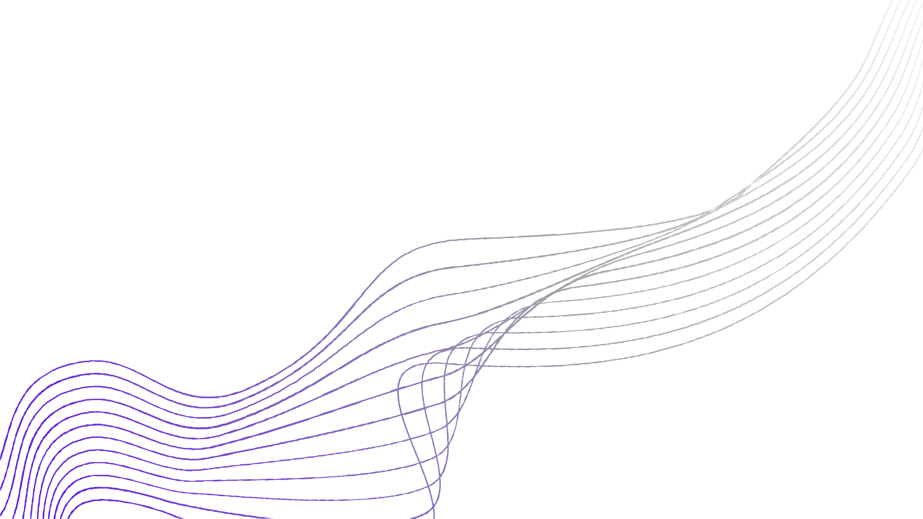
H.M.S.
HEALTH TECH
01

Slide 2
H- HOSPITAL
M- MANAGEMENT
0S2 - SYSTEM

Slide 3

TEAM MEMBERS:-
Sarah Kalim Charusee Yadav Anoushka Raizada Tushar Sharma

Slide 4
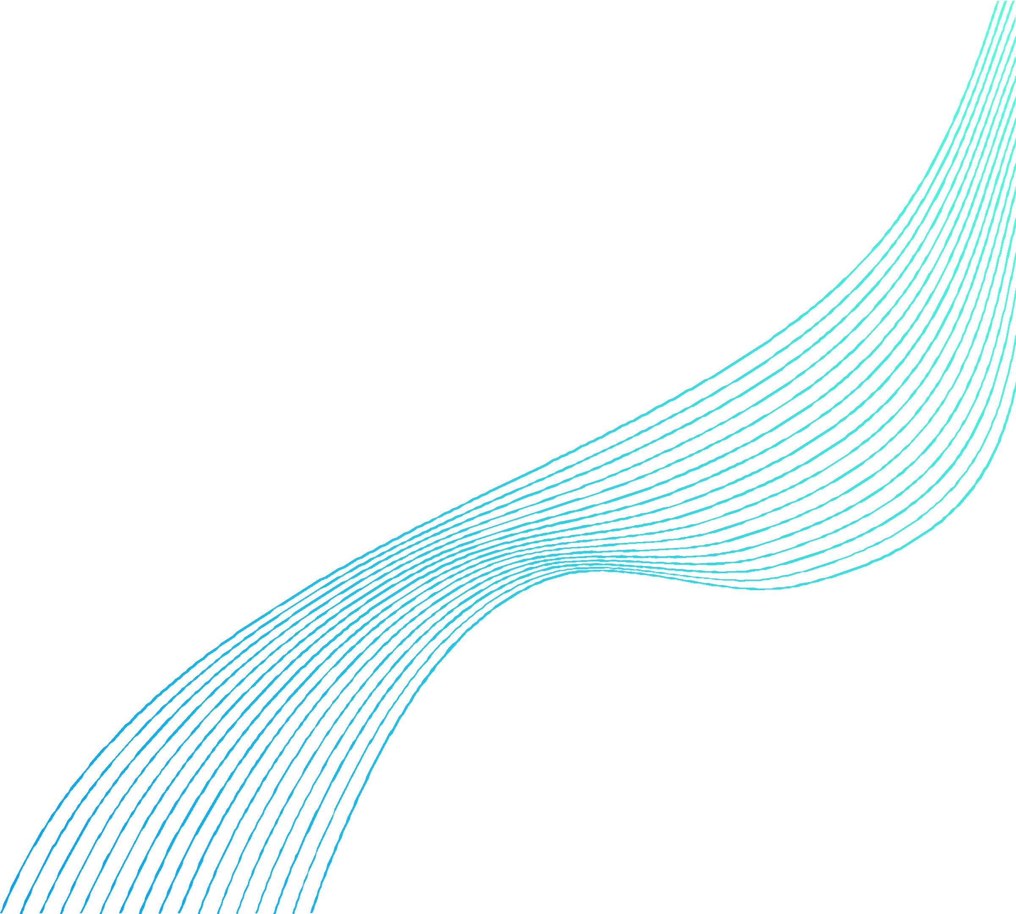



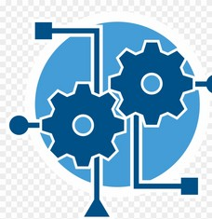
CONTENTS
Problem Statement
Solution 1 & 2
Overview
Model
05

Slide 5
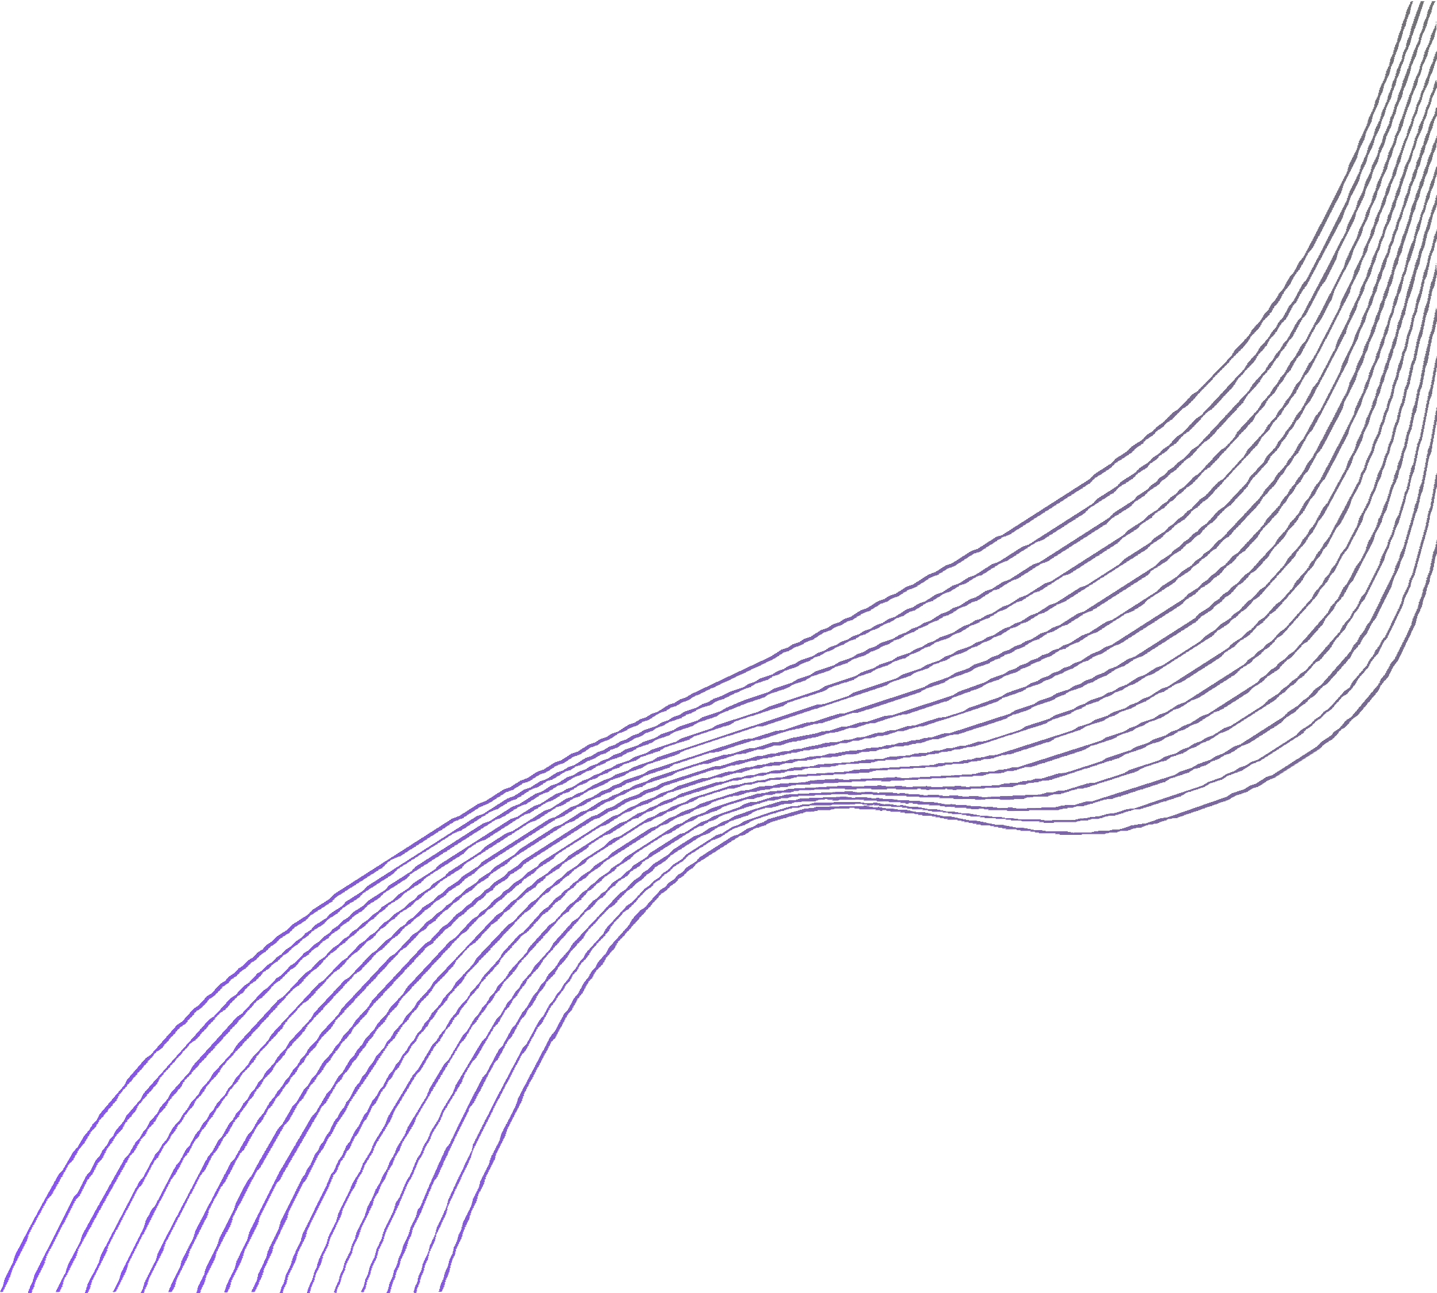
Problem Statement
Enabling a patient-centered information exchange
system
Personal medical assistant.

Slide 6
Solution 1
The possible solution for this problem is a hospital management system that keeps a record of the number of patients, and their medical histories, contact info, etc. With the help of such an interface, doctors can access medical histories and past reports easily. It saves time, and is easy to operate.

Slide 7





OVERVIEW
Advantages of a Hospital Management System
Processing Speed & Results Cost-Effective
Reduction in Errors
Data Security & Retrieving Ability Improved Patient Care
Quality & Compliance

Slide 8
Model 1
Our model starts with a login page that can only be accessed by specific users this ensures data security.
After logging in the user can access various features such as adding information of a new patient, updating and viewing the information of a specific patient.
Our model is made using Netbeans and MySQL(Java and Python).

Slide 9
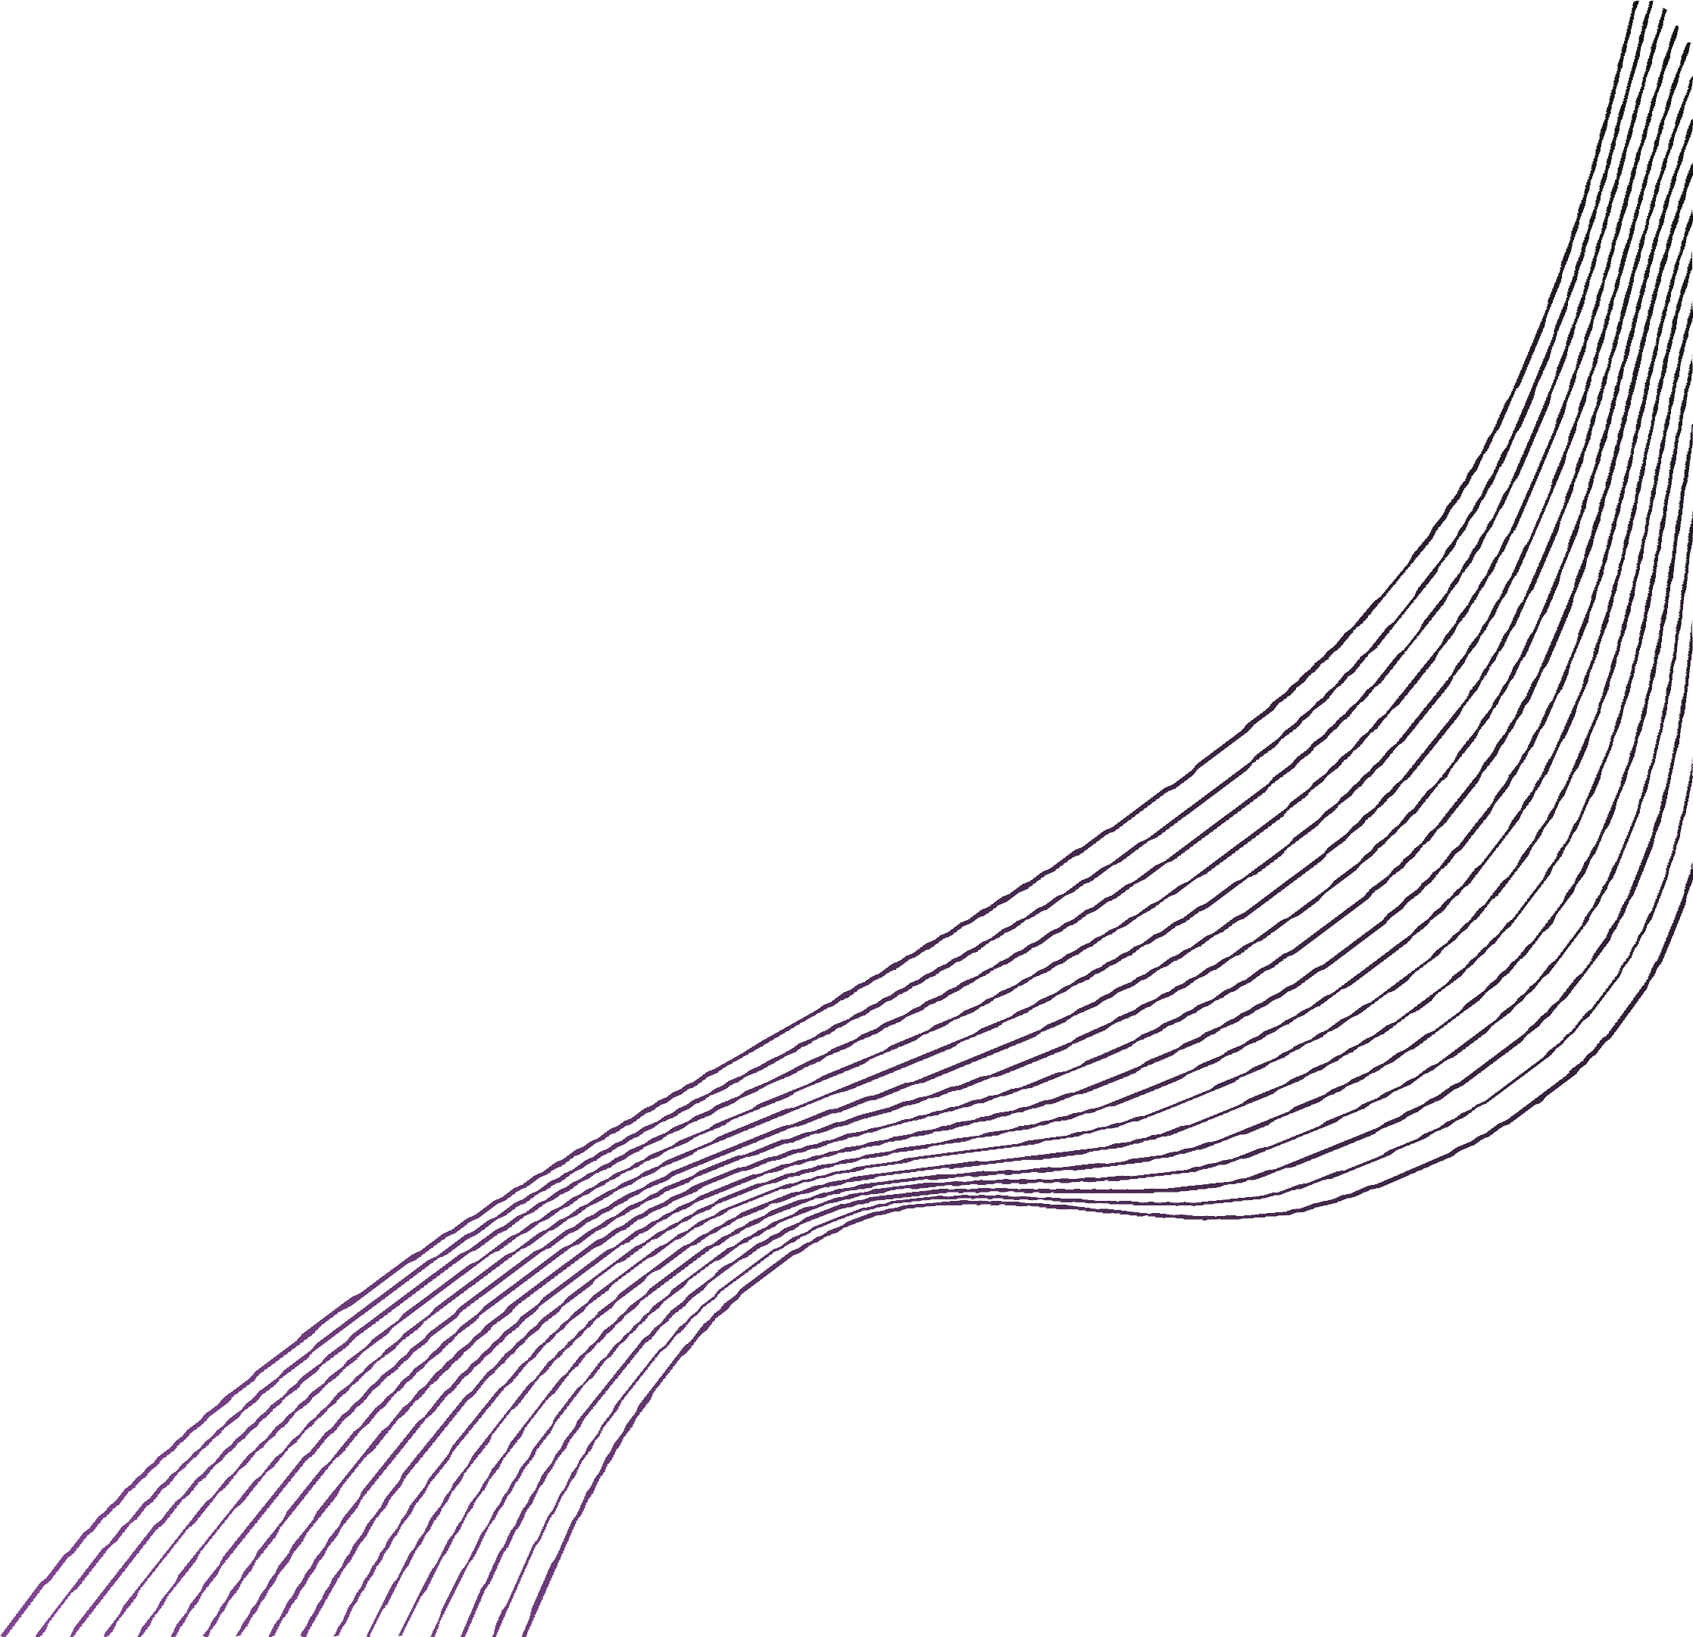
Solution 2
In most hospitals, the problem arises when you are not able to get your report on time, so the solution to this problem is that we can make a Machine Learning model that predicts whether a person is suffering from some kind of disease or not.
We have made a heart disease detection model that predicts how many people are suffering from heart disease based on the following parameters.
age
sex
cp
trestbp
chol
fbs
restecg
thalach
exang
oldpeak
slope
ca
thal
target
,

Slide 10
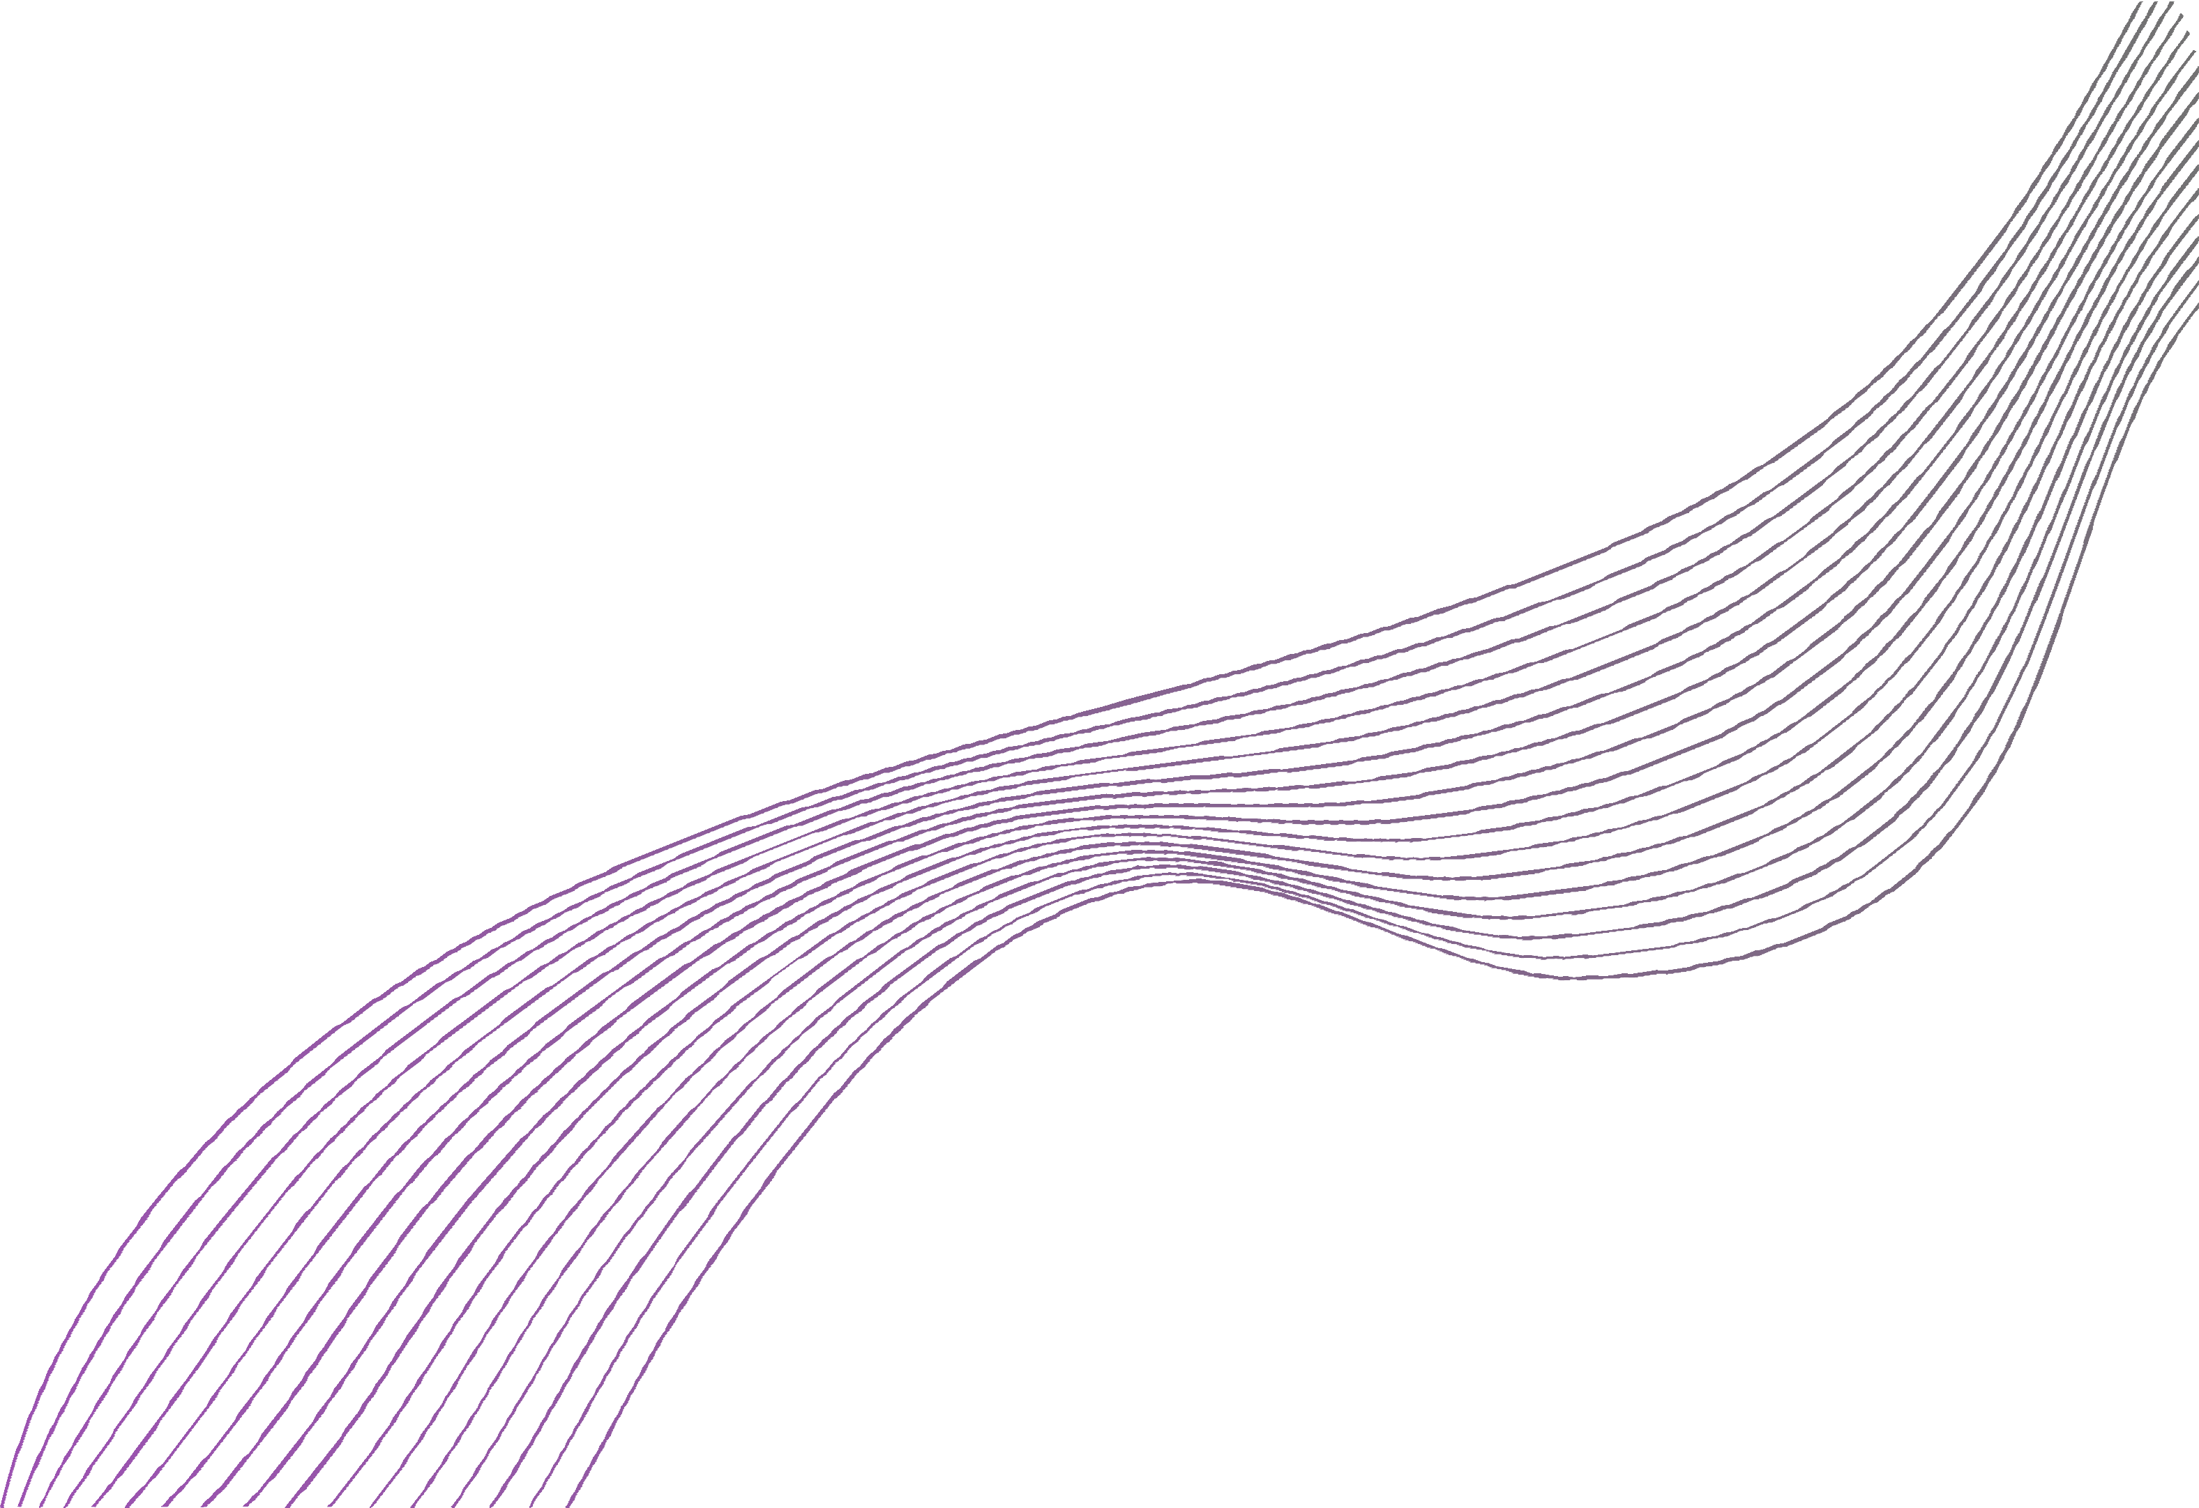


Overview
Fast and efficient results Saves Time
Cost-Efficient

Slide 11
Model -2
In this project, we have made a Machine Learning Heart Disease Prediction Model, we can implement this model with the help of an interface which will be made using Django, Tkinter. The working of this model is like whenever a person will be having a heart disease which will be predicted by this algorithm he/she will get a message via E-Mail or SMS regarding what all medicines they have to consume along with the medicines they will get their medical report. The algorithm will be like the new data of a patient will be considered as the test data and the remaining data of the dataset will be considered as the train data. In this way, the model will be able to predict the heart disease for each and every person.

Slide 12
Thankyou Everyone

